Slide 1
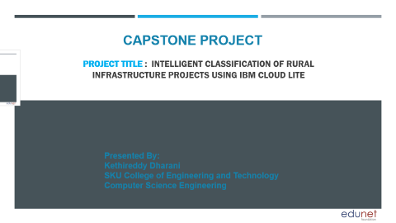
Project title : Intelligent Classification of Rural Infrastructure Projects using IBM Cloud Lite
CAPSTONE PROJECT
Presented By:
Kethireddy Dharani
SKU College of Engineering and Technology
Computer Science Engineering

Slide 2
OUTLINE
Problem Statement (Should not include solution)
Proposed System/Solution
System Development Approach (Technology Used)
Algorithm & Deployment
Result (Output Image)
Conclusion
Future Scope
References

Slide 3
Problem Statement
The Pradhan Mantri Gram Sadak Yojana (PMGSY) is a flagship rural development program in India, initiated to provide all-weather road connectivity to eligible unconnected habitations. Over the years, the program has evolved through different phases or schemes (PMGSY-I, PMGSY-II, RCPLWEA, etc.), each with potentially distinct objectives, funding mechanisms, and project specifications. For government bodies, infrastructure planners, and policy analysts, efficiently categorizing thousands of ongoing and completed projects is crucial for effective monitoring, transparent budget allocation, and assessing the long-term impact of these schemes. Manual classification is time-consuming, prone to errors, and scales poorly. Your specific task is to design, build, and evaluate a machine learning model that can automatically classify a road or bridge construction project into its correct .PMGSY_SCHEME based on its physical and financial characteristics.

Slide 4
Proposed Solution
The proposed system uses machine learning to automatically classify rural infrastructure projects under various PMGSY schemes based on physical and financial attributes.
Data Collection: Project data (length, cost, location, etc.) is collected from AI Kosh.
Preprocessing: Data is cleaned, missing values are handled, and categorical fields are encoded.
Feature Engineering: Key features like cost per km and region are extracted to improve model accuracy.
Model Training: Classification models like Random Forest or Decision Tree are trained using labeled project data.
Evaluation: Model is evaluated using accuracy, F1-score, and confusion matrix.
Deployment: Trained model is deployed using IBM Watson Studio and made accessible via a REST API on IBM Cloud Lite.
This system ensures fast, reliable classification, reducing manual effort and improving transparency in scheme allocation.

Slide 5
System Approach
1.System Requirements
Hardware: Standard PC or Cloud Notebook Environment
Software:
Python(Jupyter Notebook)
IBM Cloud Lite
IBM Watson Studio
Scikit-Learn, NumPy, Matplotlib, Pandas
2.Libraries/Tools Used
Pandas - For data loading and preprocessing
Scikit-Learn – For Model training and evaluation
Matplotlib/Seaborn – For data visualisation
IBM Watson Machine Learning – for deployment

Slide 6
Algorithm & Deployment
Chosen Algorithm: Random Forest Classifier (best suited for tabular classification problems).
Input Features:
Road/Bridge length
Total sanctioned cost
State, district, year, Number of habitations
Training Process:
Clean and encode data
Train/test split (e.g., 80:20), Hyperparameter tuning using GridSearchCV
Deployment:
Deployed on IBM Watson Machine Learning
Exposed as REST API as endpoint

Slide 7
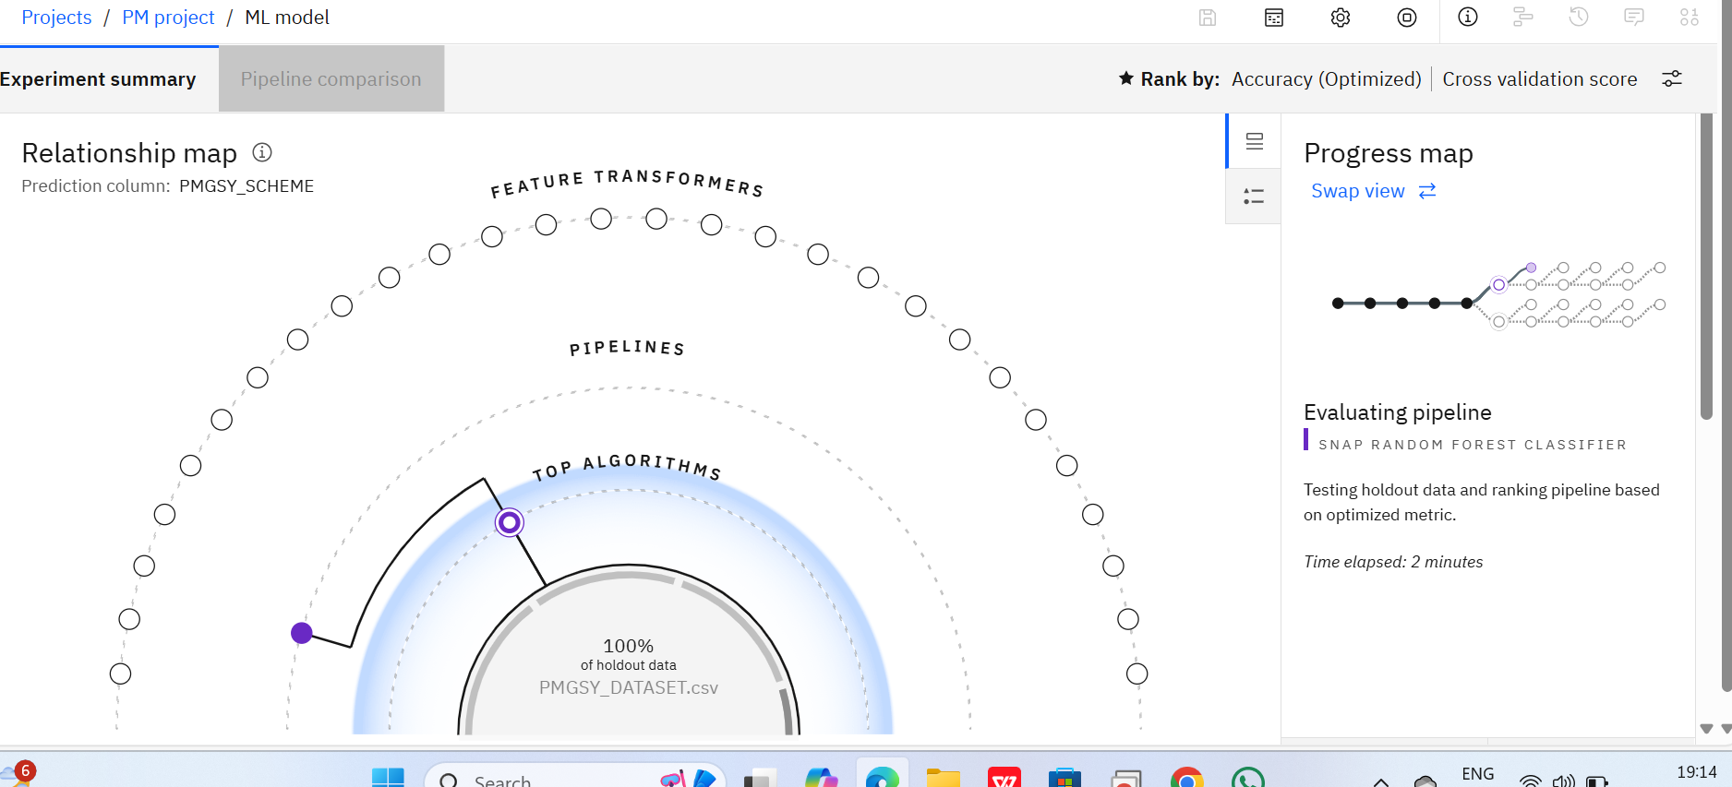
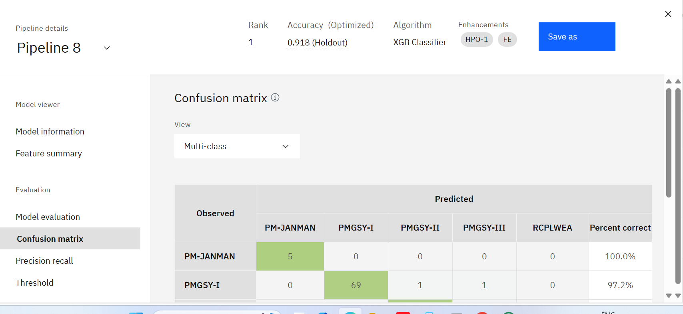
Result
.

Slide 8
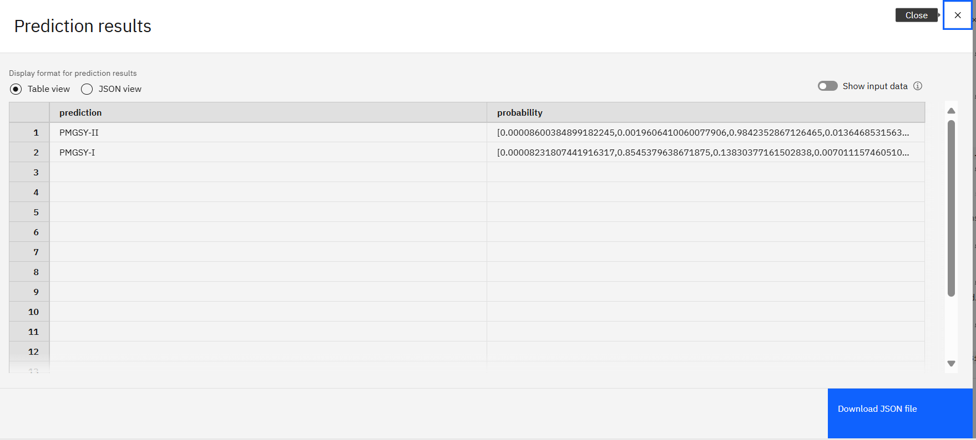
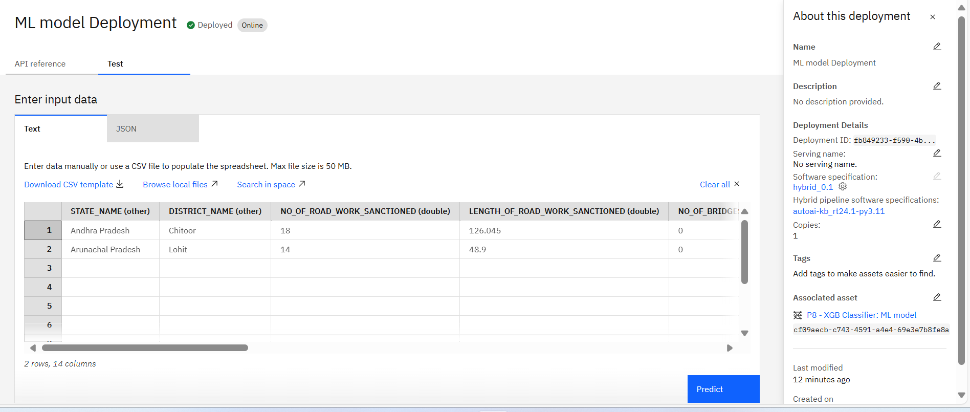
Result
.

Slide 9
Conclusion
The proposed system successfully automates the classification of rural infrastructure projects into appropriate PMGSY schemes using machine learning. By analyzing physical and financial attributes, the model improves accuracy, reduces manual effort, and enhances transparency in project categorization.
Deployment on IBM Cloud Lite using Watson Studio ensures scalability, accessibility, and real-time classification through an API. This intelligent solution supports better project monitoring, decision-making, and resource allocation in rural development programs.

Slide 10
Future scope
Integration with government portals for real-time project monitoring
Use of geospatial/satellite data to improve classification accuracy
Extendable to other rural/urban infrastructure schemes
Incorporation of deep learning or AutoML for better model performance
Development of mobile or desktop applications for field-level usage

Slide 11
References
AI Kosh Dataset – https://aikosh.indiaai.gov.in
IBM Watson Studio – https://www.ibm.com/cloud/watson-studio
IBM Cloud Lite – https://www.ibm.com/cloud/free
Scikit-learn Documentation – https://scikit-learn.org
Pandas Library – https://pandas.pydata.org
Research papers and blogs on rural infrastructure project classification and machine learning techniques

Slide 12
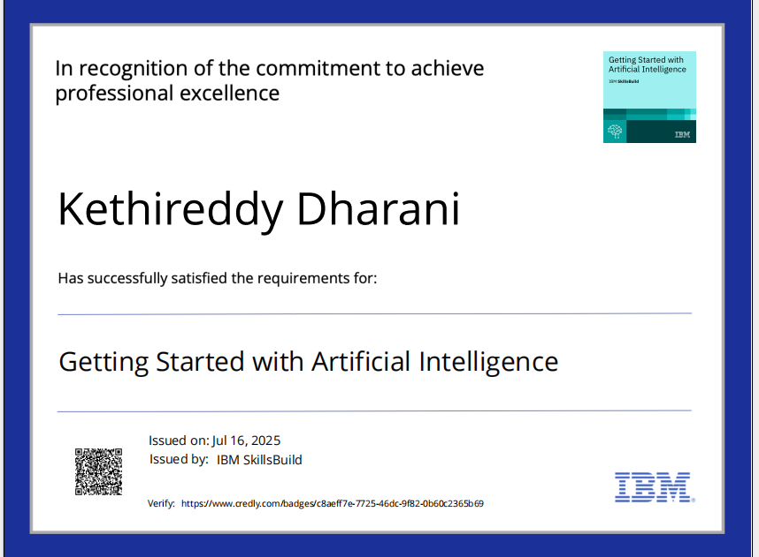
IBM Certifications

Slide 13
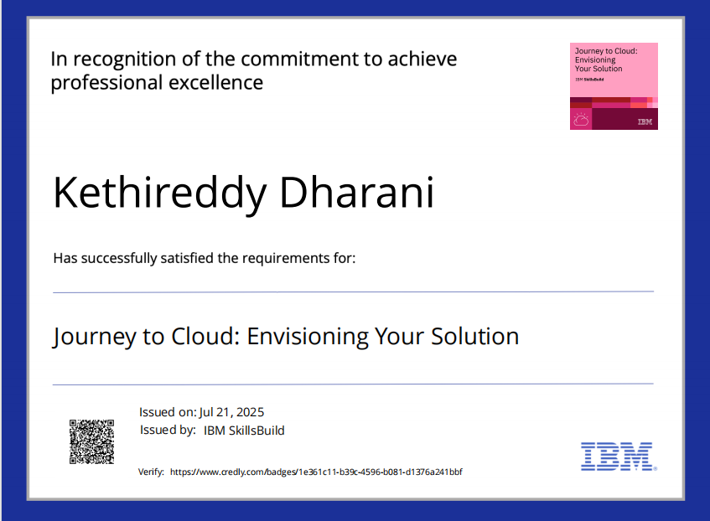
IBM Certifications

Slide 14
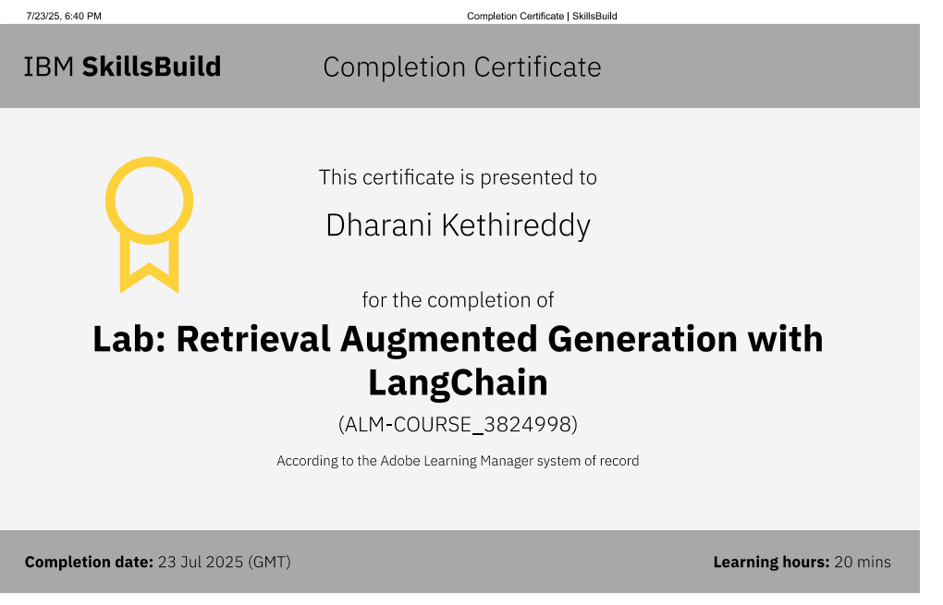
IBM Certifications

Slide 15
THANK YOU

